Slide 1

Final Project Report
Healthcare: Persistency of a drug (Data Science)
Name: Chooladeva Piyasiri
University: National Institute of Business Management (NIBM)
Email: chooladevapiyasiri@gmail.com
Country: Sri Lanka
Specialization: Data Science
Batch Code: LISUM18
Date: 30 April 2023

Slide 2
Agenda
Problem Statement
Datasets Exploration
EDA
Model Selection
Model Evaluation
Conclusion

Slide 3
Problem Statement
ABC is a pharmaceutical company. Medication persistency following a patient’s doctor's prescription is a problem that ABC, a pharmaceutical company, wants to comprehend. Persistence of drugs is the duration of time a patient takes medication, from initiation to discontinuation of therapy. To automate this identifying process, this organization has contacted an analytics firm.
The analytics firm has to create a classification for the given dataset with the aim of gathering insights on the factors that are affecting the persistency.

Slide 4
Datasets Exploration
The dataset contains 3423 observations with 26 columns and 68 features.
It contains demographic information, clinical data, other diseases as risk factor information, and information on their physician's specialty for each patient.
There are two numerical columns in the dataset, per the data type description. Which are:
Dexa_Freq_During_Rx
Count_Of_Risks
The Target Variable: Persistency_Flag
The dataset does not contain any NA values.

Slide 5

EDA

Slide 6
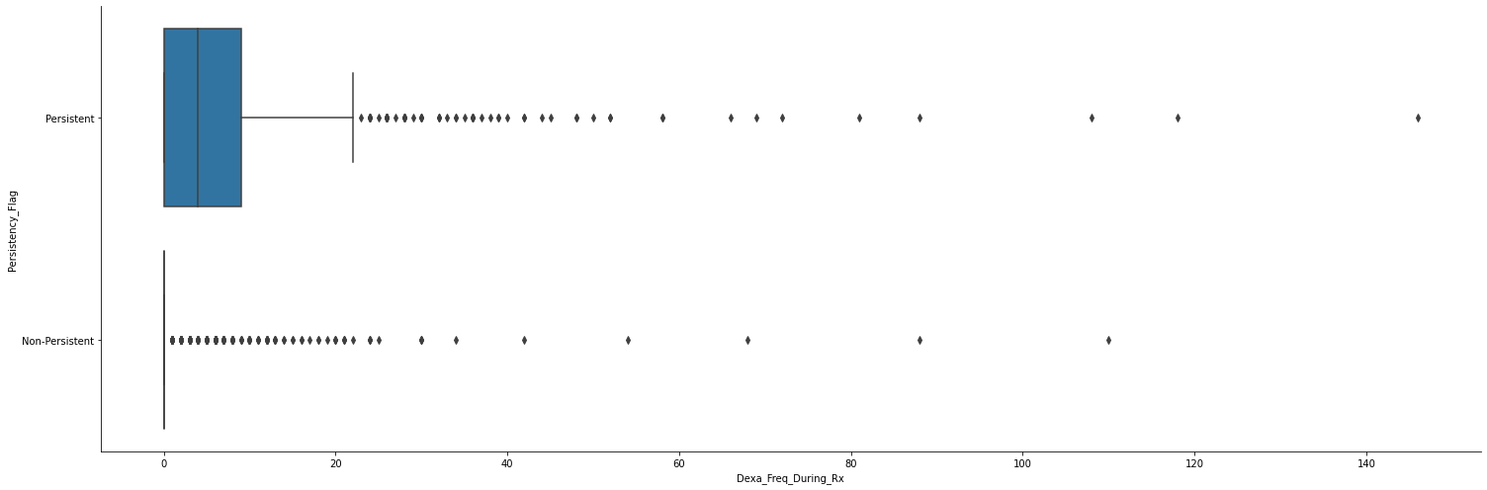
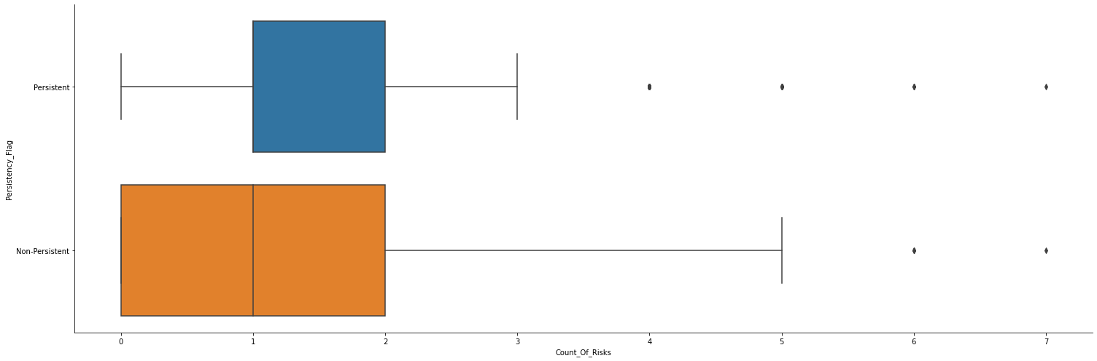
Outlier Analysis
Dexa_Freq_During_Rx
Count_Of_Risks
Both numerical features contain some outliers.
I performed the Capping and the Trimming/Removing techniques to deal with the outliers.
After removing the outliers in the Count_Of_Risks column, the number of rows in the dataset was reduced from 3424 to 3401.

Slide 7
Skewness & Kurtosis Analysis
Count_Of_Risks
The Count_Of_Risks distribution is moderately skewed. (0.879)
The Count_Of_Risks distribution is Platykurtic (kurtosis <3).
Compared to a normal distribution, its tails are shorter and thinner, and often its central peak is lower and broader. (0.900)
Dexa_Freq_During_Rx
The Dexa_Freq_During_Rx distribution is highly skewed. (6.808)
The Dexa_Freq_During_Rx distribution is Leptokurtic (kurtosis >3).
Compared to a normal distribution, its tails are longer and fatter, and often its central peak is higher and sharper. (74.758)

Slide 8
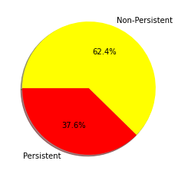
Univariate Analysis: Exploring the target variable
The target variable of the dataset is Persistency_Flag, - a flag indicating if a patient was persistent or not. The number of unique values in Persistency_Flag variable is 2. The two unique values are Persistent and Non_Persistent.
There are 2135 non-persistent patients and 1289 persistent patients in this sample.
Out of the total number of Persistency_Flag values, Non_Persistent appears 62.5% times and Persistent appears 37.5% times.

Slide 9
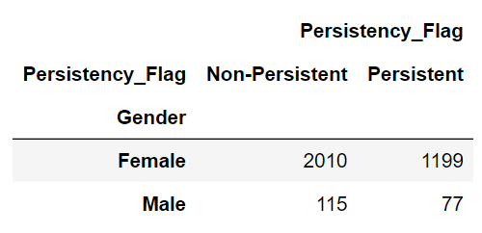
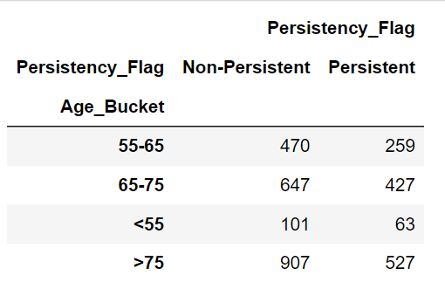
Bivariate Analysis: Demographical Feature Analysis according to the Persistency_Flag
Gender
Age Bucket
Non-persistent patients are more common in both genders than persistent patients.
The majority of persistent and non-persistent patients are over the age of 75.

Slide 10
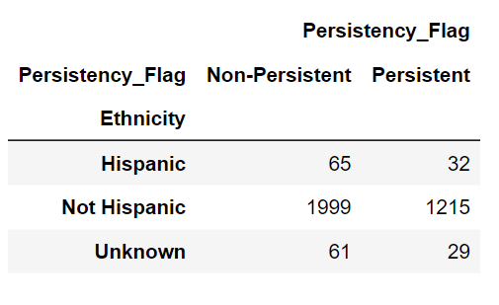
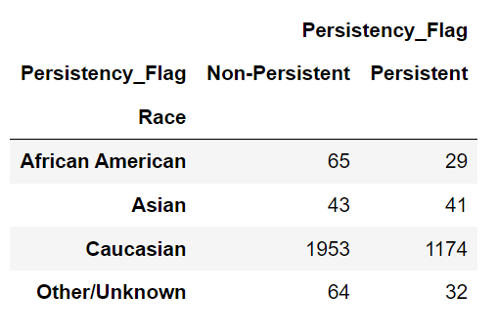
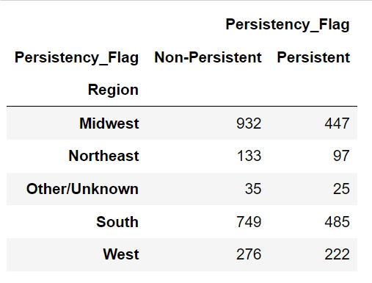
Ethnicity
Race
Region
The majority of persistent and non-persistent patients are Not Hispanic.
Caucasian patients make up the vast majority of both persistent and non-persistent patients.
The majority of persistent patients are from the Midwest, while the majority of non-persistent patients are from the South.

Slide 11
Risk, Comorbidity and Concomitant feature Analysis
Comorbidity factors are present in the majority of patients, whereas risk factors are less common.
The disorders of lipoprotein metabolism and other lipidemias (51.4%) is the most common comorbidity trait.
Vitamin D deficiency is the leading risk factor (47.4%).
Narcotics were found in 35.7% of the people. It is also the main concomitant feature.

Slide 12
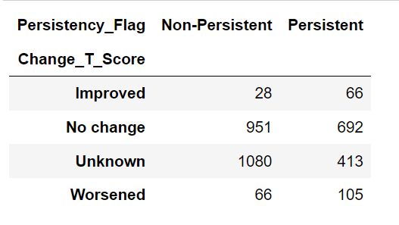
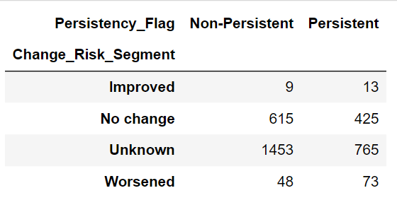
Patients' Health improvement Analysis according to Persistency_Flag
Change_T_Score
Change_Risk_Segment
The majority of persistent patients have T scores that stay unchanged after starting treatment.
A least amount of persistent and non persistent patients have improved change in Risk Segment.

Slide 13
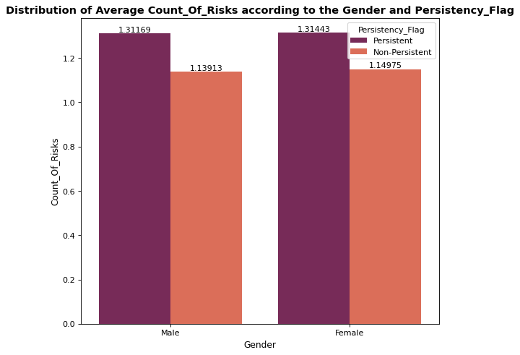
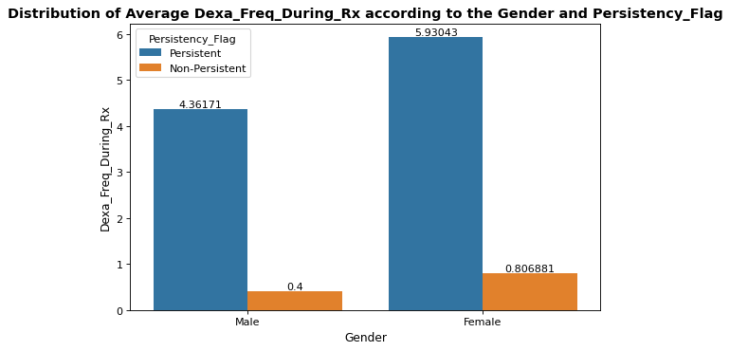
Analysis of average Count_Of_Risks, Dexa_Freq_During_Rx according to the Gender, Age Bucket and Persistency_Flag
Gender

Slide 14
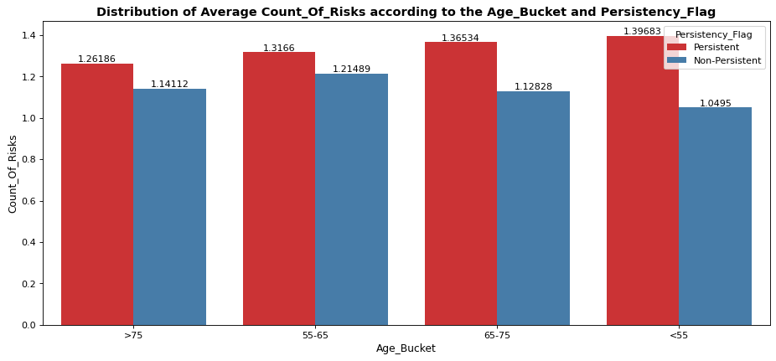
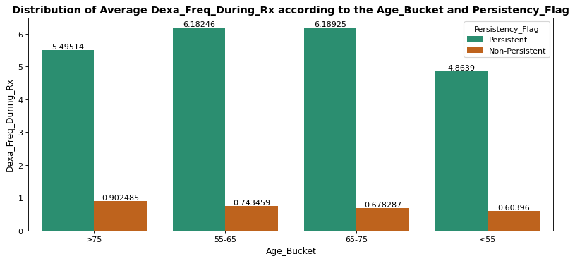
Age Bucket
The analysis represents the average distribution analysis of persistency with the gender and age bucket during Dexa_Freq_During_Rx and Count_Of_Risks administration.

Slide 15
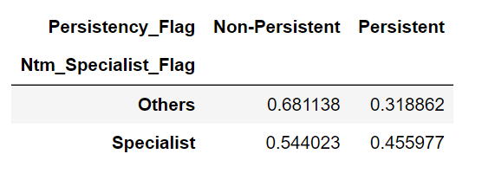
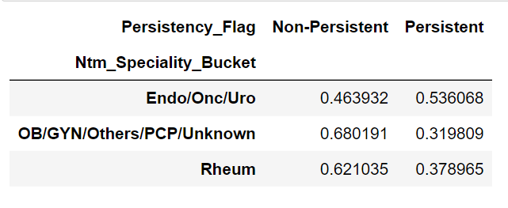
Some other Clinical and Provider Attributes Features Analysis according to the Persistency_Flag
Ntm_Specialist_Flag
Ntm_Speciality_Bucket
The normalized percentage distribution of the target variable with the NTM_Specialist_Flag and the NTM_Speciality_Bucket variables are analyzed above.

Slide 16
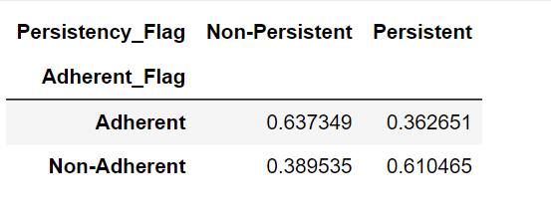
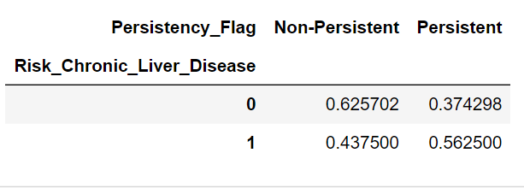
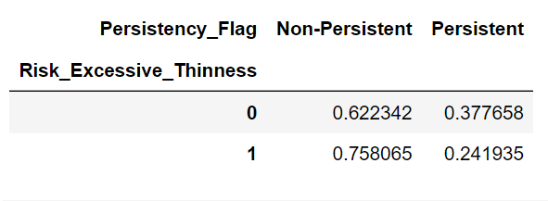
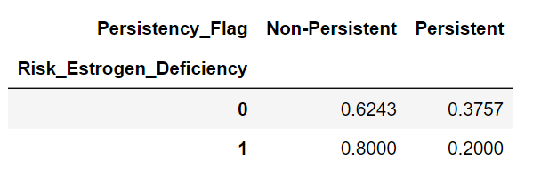
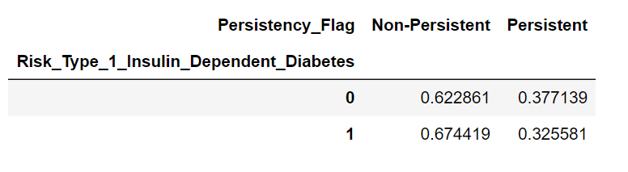
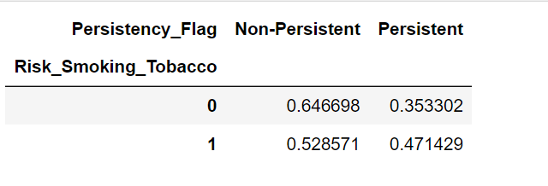

Slide 17
Model Selection
Logistic Regression: A type of linear model used for binary classification. So, whether it belongs to one of the classes or is either a 0 or a 1. It attempts to predict the output value when given several input variables, placing the example into the correct category.
Decision Tree: It builds classification or regression models in the form of a tree structure. It breaks down a dataset into smaller and smaller subsets while, at the same time, an associated decision tree is incrementally developed.
Random Forest: It builds decision trees on different samples and takes their majority vote for classification and average in the case of regression.
XGBoost Classifier: It is an implementation of gradient boosted decision trees designed for speed and performance in competitive machine learning. XGboost is an ensemble learning algorithm, meaning that it combines the results of many models.
AdaBoost Classifier: It is used as an ensemble method. The most common estimator used with AdaBoost is decision trees with one level, which means decision trees with only one split.

Slide 18

Model Evaluation

Slide 19
Model Evaluation: Metrics
Accuracy is the ratio of the number of correctly classified instances to the total number of instances. It gives an overall idea of how well the model is predicting the correct class.
Precision is the ratio of the number of true positives (correctly predicted positive instances) to the number of instances predicted as positive (both true positives and false positives). It gives an idea of how well the model is predicting the positive class and avoiding false positives.
Recall is the ratio of the number of true positives to the number of actual positive instances (both true positives and false negatives). It gives an idea of how well the model is capturing the positive class and avoiding false negatives.
The F1 score is a harmonic mean of precision and recall, calculated as 2 x (precision x recall) / (precision + recall). It provides a single score that balances both precision and recall.
Cohen's Kappa is a statistical measure that is used to assess the level of agreement between two raters or evaluators who are rating the same set of items.
The AUC score represents the area under the receiver operating characteristic (ROC) curve, which plots the true positive rate against the false positive rate at various classification thresholds.

Slide 20
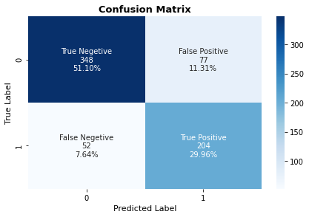
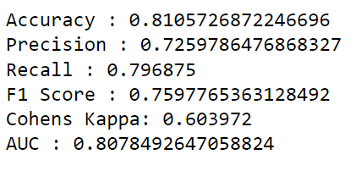
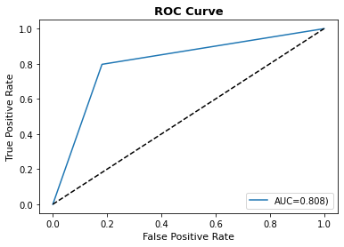
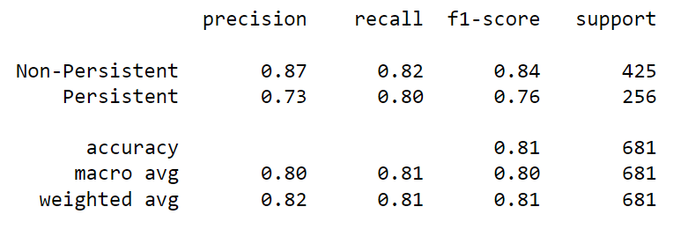
Model Evaluation: Logistic Regression

Slide 21
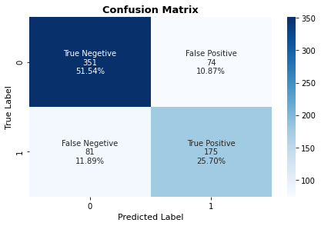
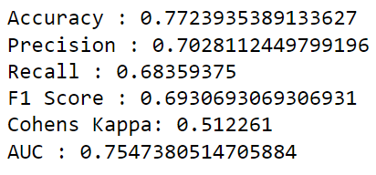
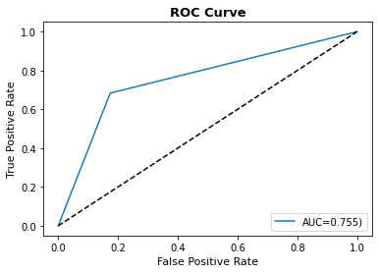
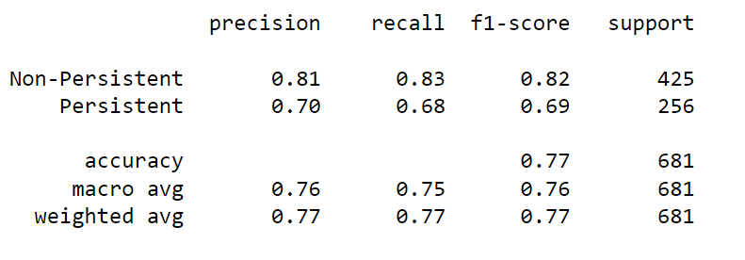
Model Evaluation: Decision Tree

Slide 22
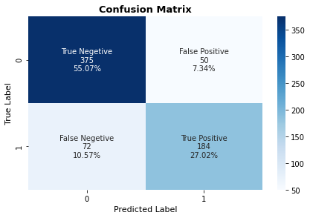
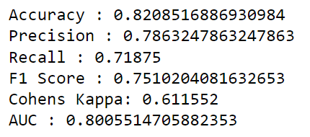
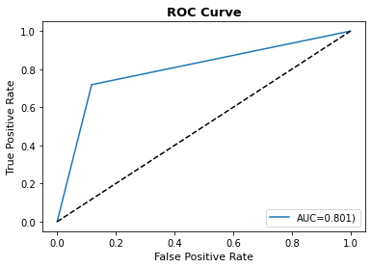
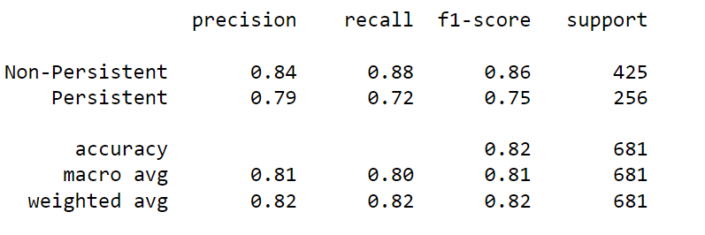
Model Evaluation: Random Forest

Slide 23
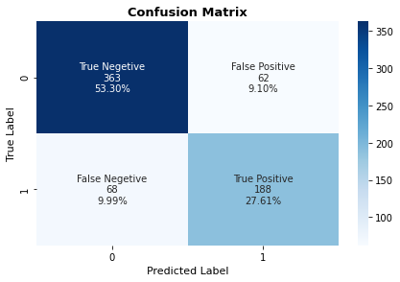
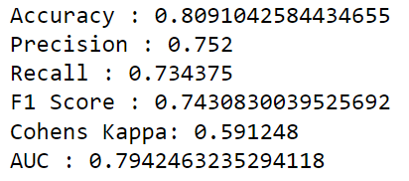
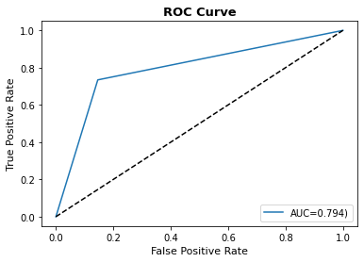
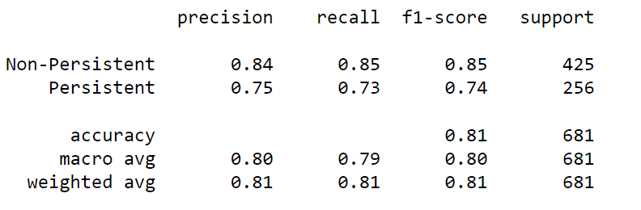
Model Evaluation: XGBoost

Slide 24
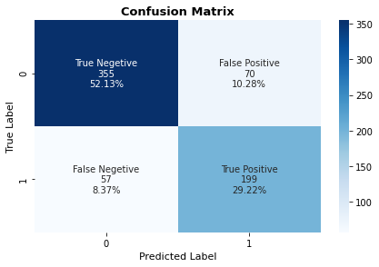
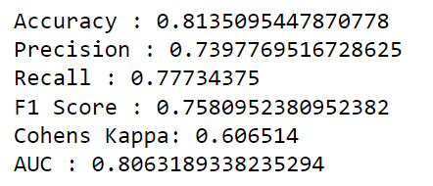
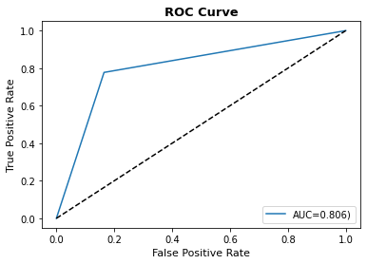
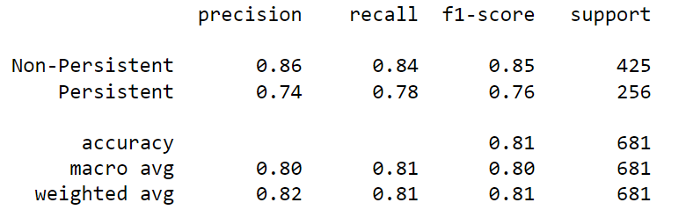
Model Evaluation: ADABoost

Slide 25
Conclusion
Model Performance Summary
Model | Accuracy | Precision | Recall | F1 Score | Cohen's Kappa | AUC Score
Logistic Regression | 81% | 72% | 79% | 75% | 60% | 80%
Decision Tree | 77% | 70% | 68% | 69% | 51% | 75%
Random Forest | 82% | 78% | 71% | 75% | 61% | 80%
XGBoost | 80% | 75% | 73% | 74% | 59% | 79%
ADABoost | 81% | 73% | 77% | 75% | 60% | 80%
The study found that Random Forest, Logistic Regression, and ADABoost are the top-performing models.

Slide 26
Thank You

